Slide 1

Customer Shopping Behavior Analysis
This project analyzes customer shopping behavior using transactional data from 3,900 purchases. Our goal is to uncover insights into spending patterns, customer segments, product preferences, and subscription behavior to guide strategic business decisions.

Slide 2

Project Overview & Dataset Summary
We analyzed 3,900 purchases across various product categories, utilizing 18 key features to understand customer behavior.
Key Features
Dataset Snapshot
Customer demographics (Age, Gender, Location, Subscription Status)
Purchase details (Item, Category, Amount, Season, Size, Color)
Shopping behavior (Discount, Promo Code, Previous Purchases, Frequency, Review Rating, Shipping Type)
Rows: 3,900
Columns: 18
Missing Data: 37 values in Review Rating

Slide 3
Exploratory Data Analysis in Python
Our initial phase involved comprehensive data preparation and cleaning using Python to ensure data quality and readiness for analysis.
01
02
03
Data Loading & Exploration
Missing Data Handling
Column Standardization
Imported dataset with pandas, then used `df.info()` and `.describe()` for initial structural and statistical checks.
Null values in 'Review Rating' were imputed using the median rating per product category.
Renamed columns to `snake_case` for improved readability and consistency.
04
05
Feature Engineering
Data Consistency & Integration
Created `age_group` and `purchase_frequency_days` columns for deeper insights.
Verified and dropped redundant `promo_code_used` column. Loaded cleaned data into PostgreSQL for SQL analysis.

Slide 4
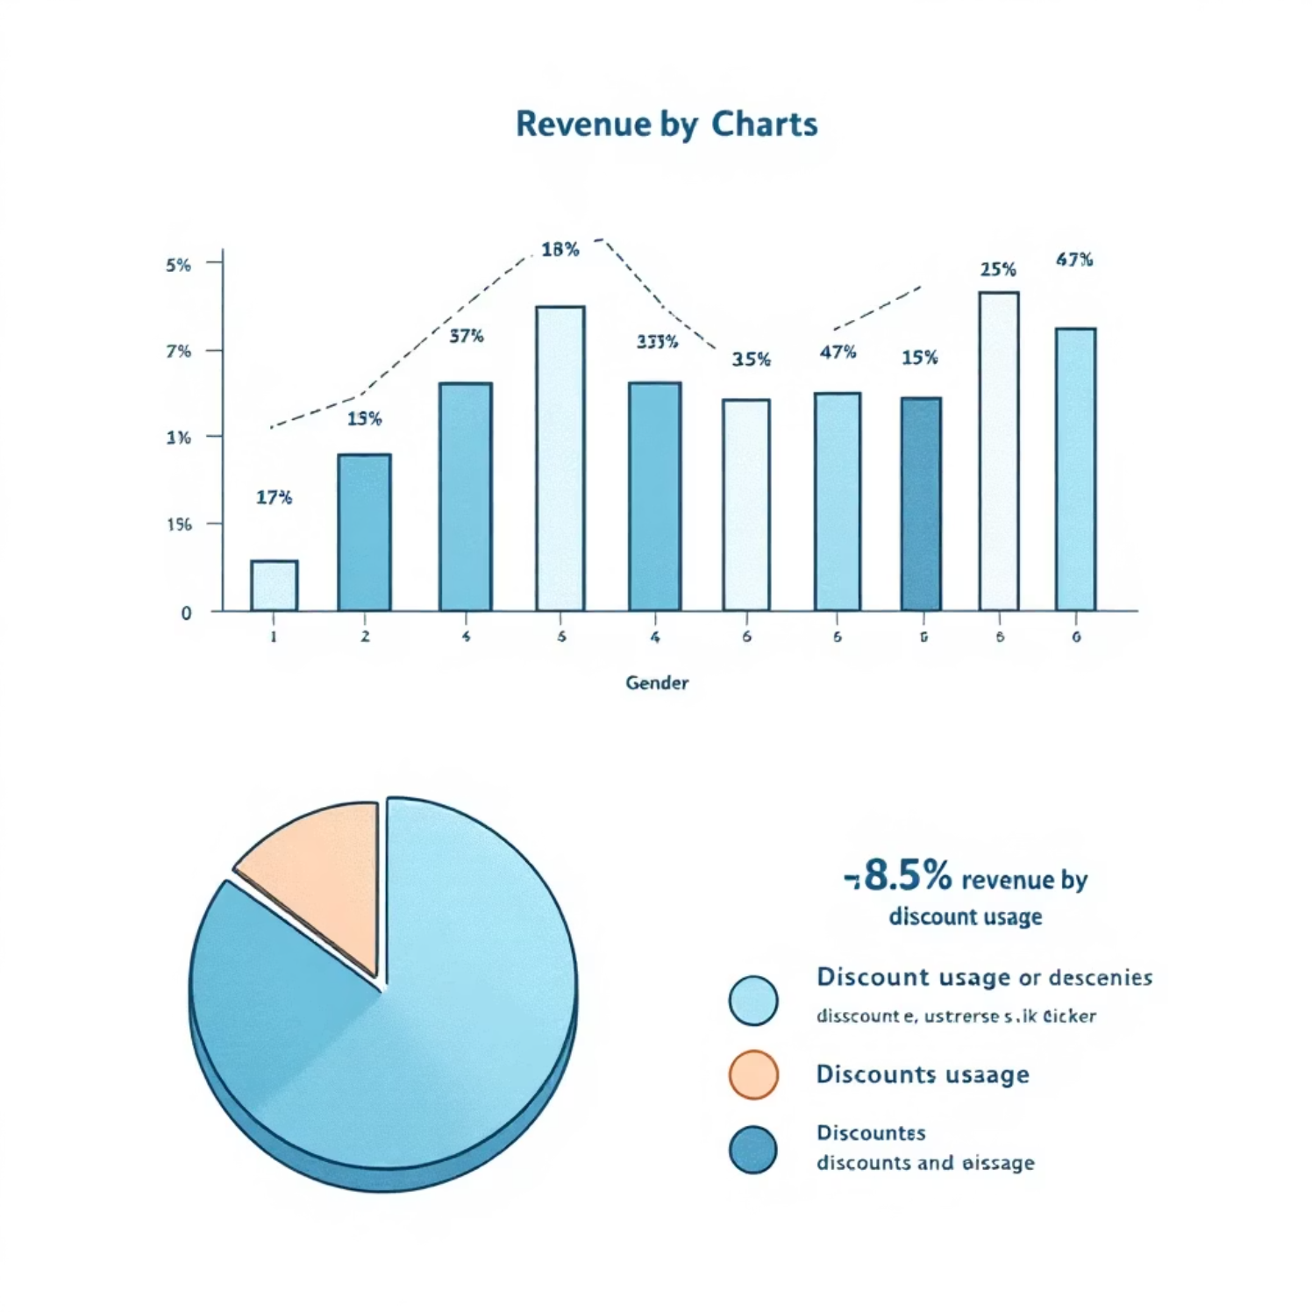
Revenue Insights: Gender & Discounts
Revenue by Gender
High-Spending Discount Users
Male customers generated significantly higher revenue compared to female customers.
839 customers used discounts but still spent above the average purchase amount, indicating effective discount strategies for high-value segments.
Female
75191
Male
157890

Slide 5
Product Performance & Shipping Preferences
Top 5 Products by Rating
Shipping Type Comparison
Gloves and Sandals lead with the highest average review ratings, indicating strong customer satisfaction.
Express shipping users show a slightly higher average purchase amount compared to standard shipping users.
Gloves
3.86
Standard
58.46
Sandals
3.84
Express
60.48
Boots
3.82
Hat
3.80
Skirt
3.78

Slide 6
Subscription Impact & Discount Dependency
Subscribers vs. Non-Subscribers
Discount-Dependent Products
Non-subscribers represent a larger customer base and higher total revenue, while average spend is similar across both groups.
Hats and Sneakers show the highest percentage of purchases made with discounts, suggesting these items are highly sensitive to promotions.
Yes
1053
59.49
62645.00
Hat
50.00
No
2847
59.87
170436.00
Sneakers
49.66
Coat
49.07
Sweater
48.17
Pants
47.37

Slide 7
Customer Segmentation & Product Categories
Customer Segmentation
Top 3 Products per Category
Customers are segmented into Loyal, Returning, and New based on their purchase history, with Loyal customers forming the largest group.
Jewelry, Blouse, Sandals, and Jacket are consistently top sellers within their respective categories.
Accessories
Jewelry
171
Loyal
3116
Clothing
Blouse
171
New
83
Footwear
Sandals
160
Returning
701
Outerwear
Jacket
163

Slide 8
Repeat Buyers & Age Group Revenue
Repeat Buyers & Subscriptions
Revenue by Age Group
A significant number of repeat buyers (over 5 purchases) are not subscribed, indicating an opportunity to convert them.
Young Adults contribute the highest total revenue, followed closely by Middle-aged customers.
No
2518
Young Adult
62143
Yes
958
Middle-aged
59197
Adult
55978
Senior
55763

Slide 9
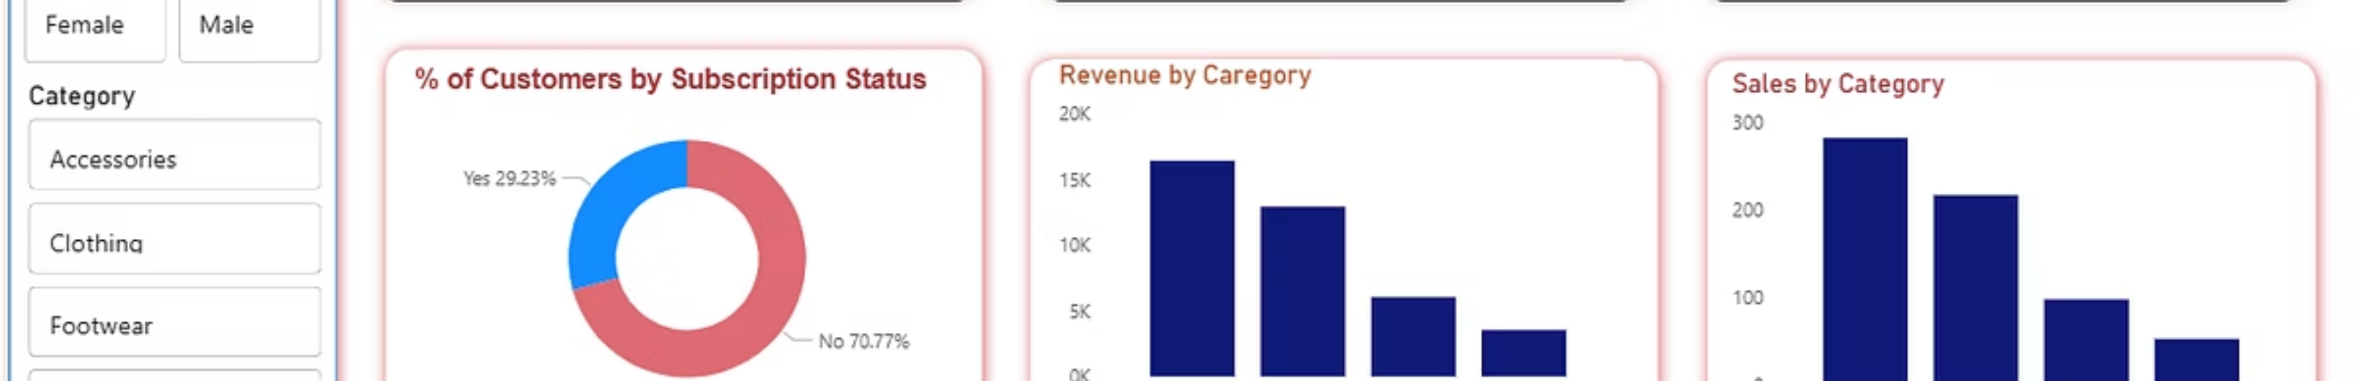
Power BI Dashboard: Visualizing Insights
An interactive Power BI dashboard was created to visually present key metrics and insights, enabling easy exploration of customer behavior data.
3.9K
$59.76
3.75
Number of Customers
Average Purchase Amount
Average Review Rating

Slide 10

Strategic Business Recommendations
Based on our analysis, we propose several key recommendations to optimize business strategies and enhance customer engagement.
Boost Subscriptions
Customer Loyalty Programs
Review Discount Policy
Product Positioning
Promote exclusive benefits to increase subscriber conversion and retention.
Highlight top-rated and best-selling products in marketing campaigns.
Implement programs to reward repeat buyers and foster long-term loyalty.
Strategically adjust discount policies to balance sales growth with profit margins.
Targeted Marketing
Focus marketing efforts on high-revenue age groups and express-shipping users for maximum impact.

